Slide 1
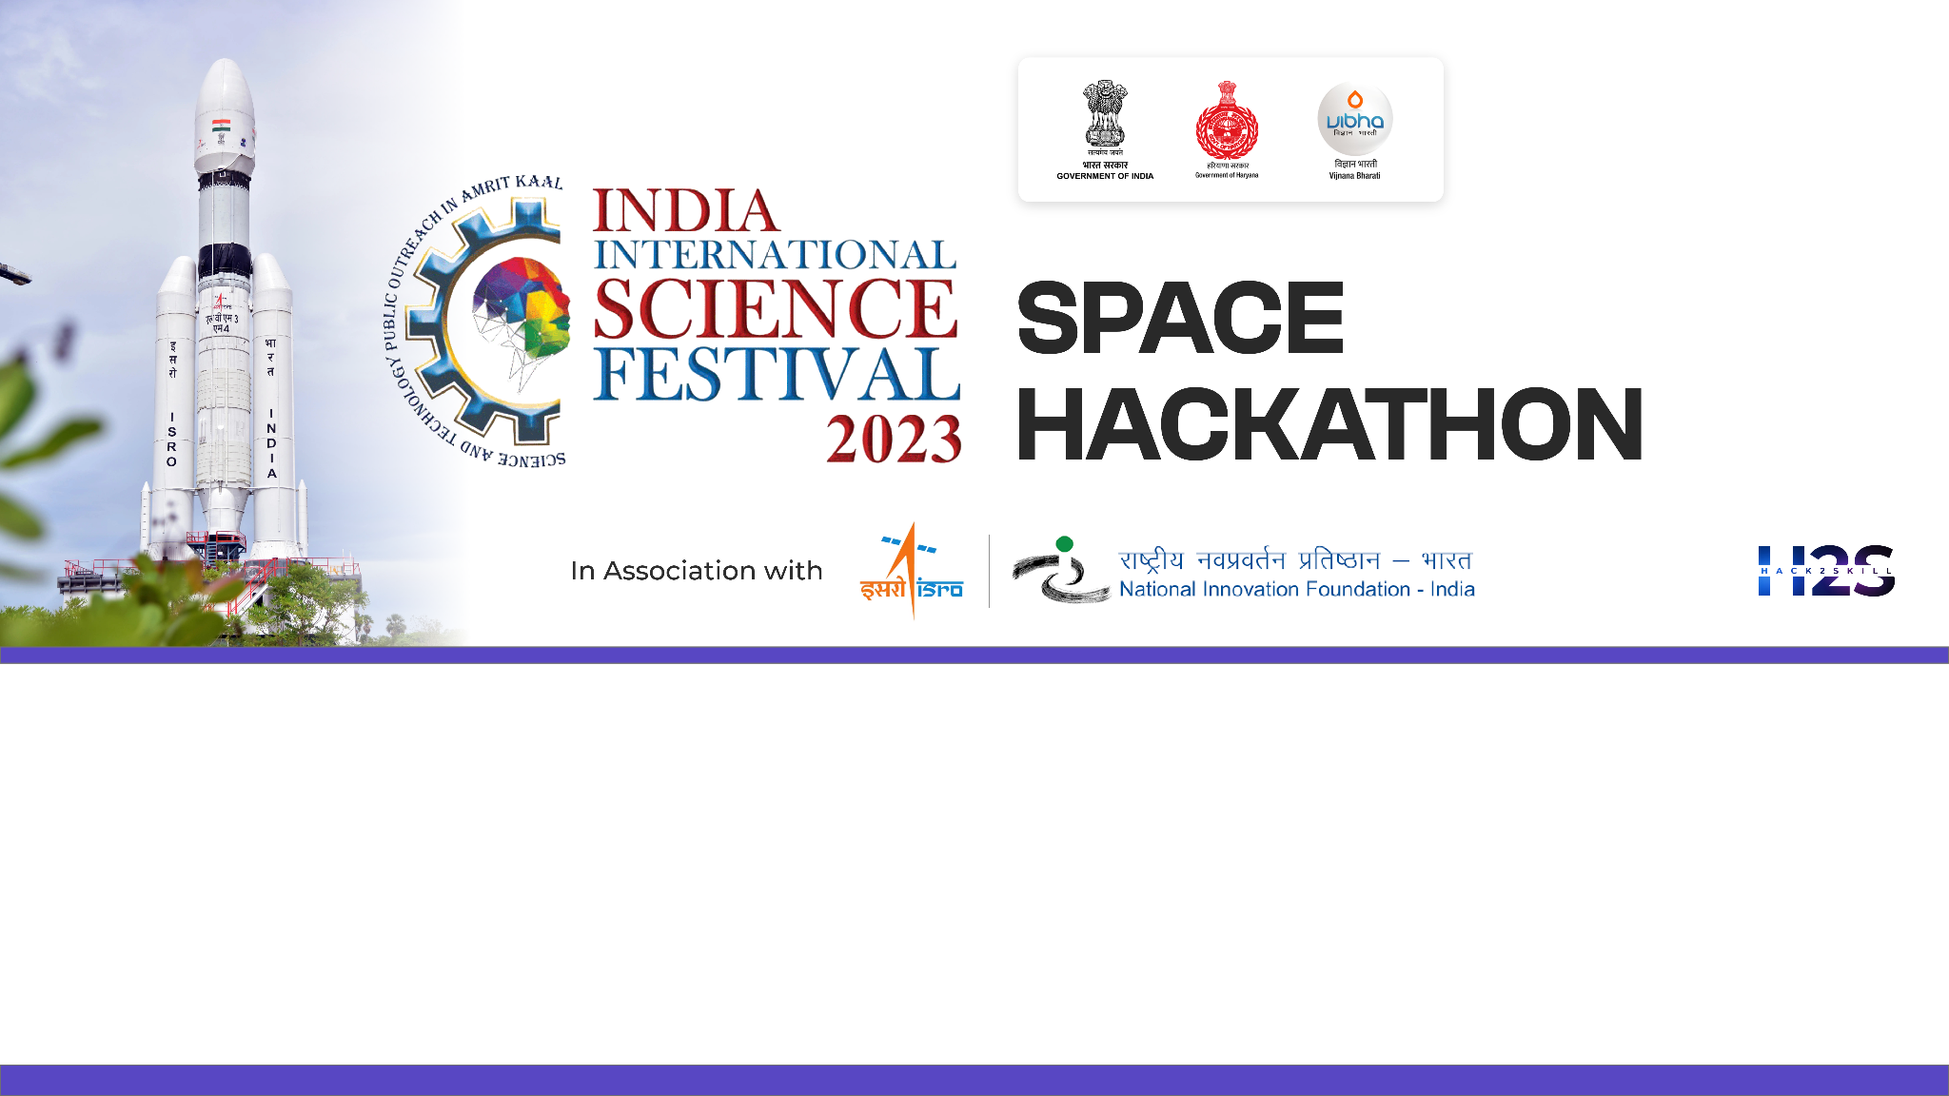

Team Name: Geo-Extractors
Name of College/University: Andhra University College Of Engineering
Team Member Details:
BANDI JAYASATYADURGARAO
JAGU MANISH
GAUTAM KUMAR KUSHWAHA
CHATTI VENKATA RAVITEJA

Slide 2

Problem Statement: Feature Extraction from RS‐HR data using AIML
MOTIVATION:
The challenge in remote sensing lies in extracting vital features like Farm Pond, Check Dam, Nala Pond, Dug Wells, High Tension Tower, Windmill, etc.. from HR-Satellite images for applications like utility management and planning, water resource management, renewable energy, etc.
Manual identification is error-prone (Human expert decision-based errors), Laborious, and time-consuming.
To create a feature extraction knowledge engine, by incorporating hybrid ML, DL, and CNN models.
BENEFITS:
Advanced automated analysis of satellite imagery across varied environments for diverse applications.
Resolution-Agnostic Multi-Label Classification Model.
Robust Across Scales.
Customized labeled Datasets for multiple features.
Adaptability to New Feature Types.
Extensive Generalization.
Harnessing Multi-Temporal Image Stacks for Enhanced Predictive Power.
OUR SOLUTION:
Class-wise labels are generated by taking ground validation data, employing various Image segmentation techniques to label distinct features, complemented by applying diverse OBIA classification methods through Deep neural networks(CNN).
Creating an Automated multi-label classification model entails initial training with diverse datasets, followed by retraining using meticulously crafted labeled datasets that cover various features. The model then outputs bounding boxes for each detected feature, accompanied by corresponding confidence scores.
Automatic Feature extraction model with a state-of-the-art multi-label classification system that delivers precision through bounding boxes or masks, and confidence scores for each identified feature.
Leveraging data augmentation techniques to enhance the robustness and accuracy of our model when processing satellite imagery.

Slide 3
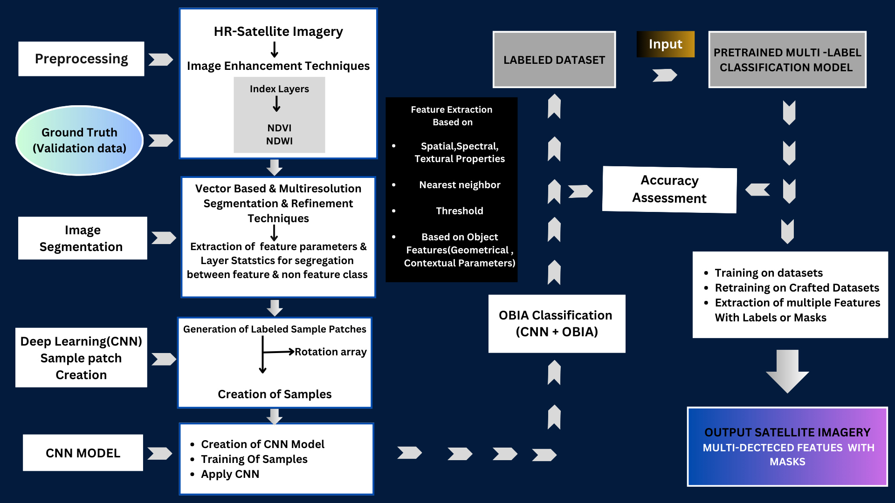
DETAILED METHODOLOGY

Slide 4
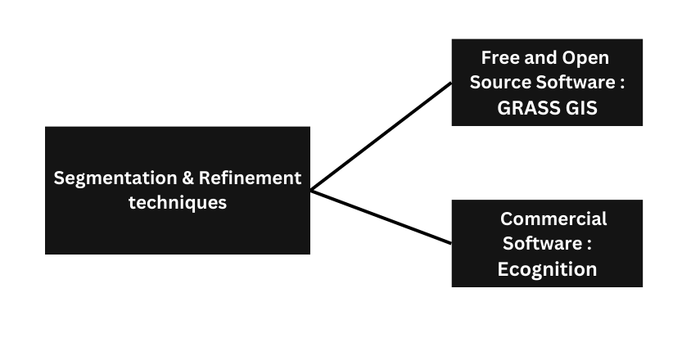
Detailed Proposal & Solution Approach
Preprocess Satellite Imagery: After satellite image corrections, individual bands generate indices like NDVI and NDWI, crucial for isolating objects in segmentation or classification.
Spatial-spectral features based Deep neural network model.
Performance matrix and outcomes
Good Spatial Precision: Intersection over Union(IoU).
Holistic Class Inclusion and Adaptability.
Comprehensive Evaluation Mastery.

Slide 5
Tools and devices used in development:
eCognition
GRASS GIS
QGIS
ERDAS IMAGINE
OpenCV
PyTorch
TensorFlow
Jupyter Notebook
Technologies involved/used:
GIS(Geographic Information System)
Remote Sensing
Digital Image Processing
AI/ML/DL(CNN)
OBIA (Object-Based Image Analysis)
LiDAR Imaging
Environmental Dependencies
Data Quality and Variability
Computational Resource Requirements
References/Acknowledgement
Kucharczyk, M., Hay, G. J., Ghaffarian, S., & Hugenholtz, C. H. (2020). Geographic Object-Based Image Analysis: A Primer and future directions. Remote Sensing, 12(12), 2012. https://doi.org/10.3390/rs12122012
O’Neil‐Dunne, J., Specialist, G., & Pelletier, K. C. (2011b). Incorporating contextual information into object-based image analysis workflows. INCORPORATING CONTEXTUAL INFORMATION INTO OBJECT-BASED IMAGE ANALYSIS WORKFLOWS, 387–397. https://www.asprs.org/a/publications/proceedings/Milwaukee2011/files/ONEILDUNNE.pdf
Chen, G., Weng, Q., Hay, G. J., & He, Y. (2018). Geographic object-based image analysis (GEOBIA): emerging trends and future opportunities. Giscience & Remote Sensing, 55(2), 159–182. https://doi.org/10.1080/15481603.2018.1426092
Tripathi, M. (2021). Analysis of Convolutional Neural Network-based Image Classification Techniques. Journal of Innovative Image Processing, 3(2), 100–117. https://doi.org/10.36548/jiip.2021.2.003

